Slide 1
C_lines
A self-play reinforcement-learning agent for an original board game — and quantitative evidence it improves with experience
ITRI 616 — Artificial Intelligence 1 · 8×8 board · points-until-full · run_pts_002 (10,000 self-play games)

Slide 2
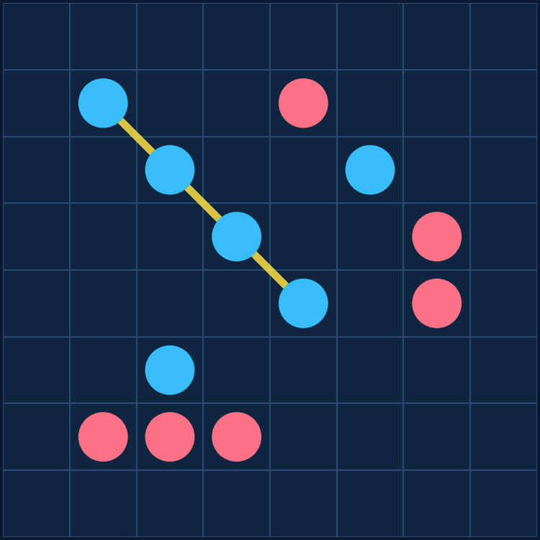
The game: C_lines on an 8×8 board
PROBLEM DEFINITION
• Open placement — players alternate, placing one stone on ANY empty cell; no gravity, no column rule.
• Board fills — play continues until all 64 cells are occupied.
• Line scoring — score for straight runs (any direction) of length 3–8; longer lines worth far more (3 → 0.25 … 8 → 5.0).
• Win condition — highest total score when the board fills; a tie-break removes draws.
• Why it is hard — 64 opening moves; you must BUILD your own lines and BLOCK the opponent over a 64-move horizon. It is an original game, so no engine exists to copy.

Slide 3
The learning problem — Task · Experience · Performance
PROBLEM DEFINITION & TEP FRAMEWORK
T
Task
E
Experience
P
Performance
Choose the placement that maximises the final score margin (own − opponent). Category: sequential DECISION-MAKING / CONTROL — not classification, not prediction.
Self-generated games: a short warm-up vs Random & Heuristic, then SELF-PLAY against frozen past versions. As the agent improves, so do its opponents — an automatic curriculum.
Four metrics every 100 games: win rate vs Random, vs Heuristic, an Elo rating, and win rate vs a 4-ply Alpha-Beta search.
Goal of the assignment: demonstrate that performance improves with experience.

Slide 4
The algorithm: a self-play Deep Q-Network
TECHNICAL UNDERSTANDING & METHODOLOGY
10-channel board state
Residual CNN (4 blocks, 64ch)
Q-value per cell
ε-greedy move
→
→
→
Learning loop: transitions are stored in a replay buffer and feed gradient updates.
Why DQN?
• Sequential control with delayed reward — a move's value only emerges when the board fills.
• Q-learning's TD target is built for that credit assignment.
• No labelled 'correct' moves exist for an original game, so supervised learning does not apply.
Reward design
• Dense delta-score shaping: per-move change in (own − opponent) score.
• Plus a terminal ±1 for the win / loss.
• Perfectly aligned with the objective — every step points to the same goal as the final outcome.

Slide 5
Three implementation choices that make it work
TECHNICAL UNDERSTANDING & METHODOLOGY
Negamax value target
The next position is the OPPONENT's, so the bootstrap is subtracted, not added: target = r − γ·max Q(s′). The single most important correctness property of two-player value learning.
Double DQN + Huber loss
The online net selects the action, the target net evaluates it — cutting overestimation. Huber loss keeps updates stable against large TD errors. Together: no late-run collapse.
D4 symmetry augmentation
Every board is also 7 rotations / reflections — multiplying training data eight-fold for free and regularising toward the board's true symmetry.
Plus: target-network sync, gradient clipping, plateau LR decay, and snapshotting every 1,000 games into 10 playable difficulty levels.

Slide 6
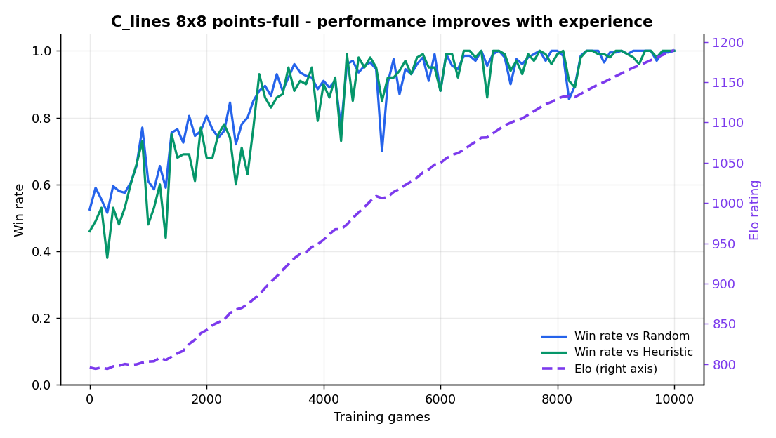
Result: performance improves with experience
RESULTS PRESENTATION & ANALYSIS
796 → 1190
Elo (monotone, +394)
52.5% → 100%
Win rate vs Random
46% → 100%
Win rate vs Heuristic

Slide 7
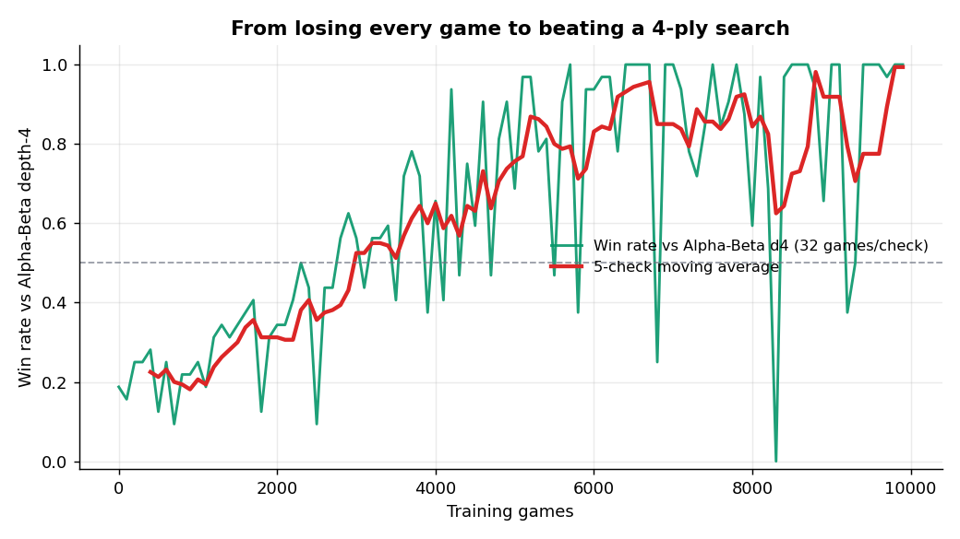
The decisive test: beating a 4-ply search
RESULTS PRESENTATION & ANALYSIS
vs Alpha-Beta depth-4
an opponent the agent NEVER trains against
19% → 100%
win rate
−0.83 → +1.17
mean score margin (sign flips)
Winning by a margin against an independent search = genuine generalisation, not memorisation.

Slide 8
Critical analysis
CRITICAL THINKING
Model
Residual CNN matches local line patterns; tactical channels free the network to weigh threats, not relearn rules.
Method
Negamax target keeps the value function coherent; Double-DQN + Huber explain the stable, collapse-free convergence.
Results
Win rates saturate at 100% — Elo keeps resolving improvement; the per-snapshot noise is why Elo is the headline.
Improve
Multi-seed bands, n-step returns, an AlphaZero-style policy + MCTS head, and a deeper benchmark.

Slide 9
A self-play DQN learned an original board game — from a blank slate to out-playing a 4-ply search
IN ONE SENTENCE
1,190
final Elo
100%
vs Random, Heuristic & AB-d4
10,000
self-play games
Clear, quantitative evidence that performance improves with experience. Every result is reproducible from the logged data with one command.
python -m src.training.train --games 10000 --size 8 --benchmark alphabeta_d4
Thank you - questions welcome.

